Slide 1
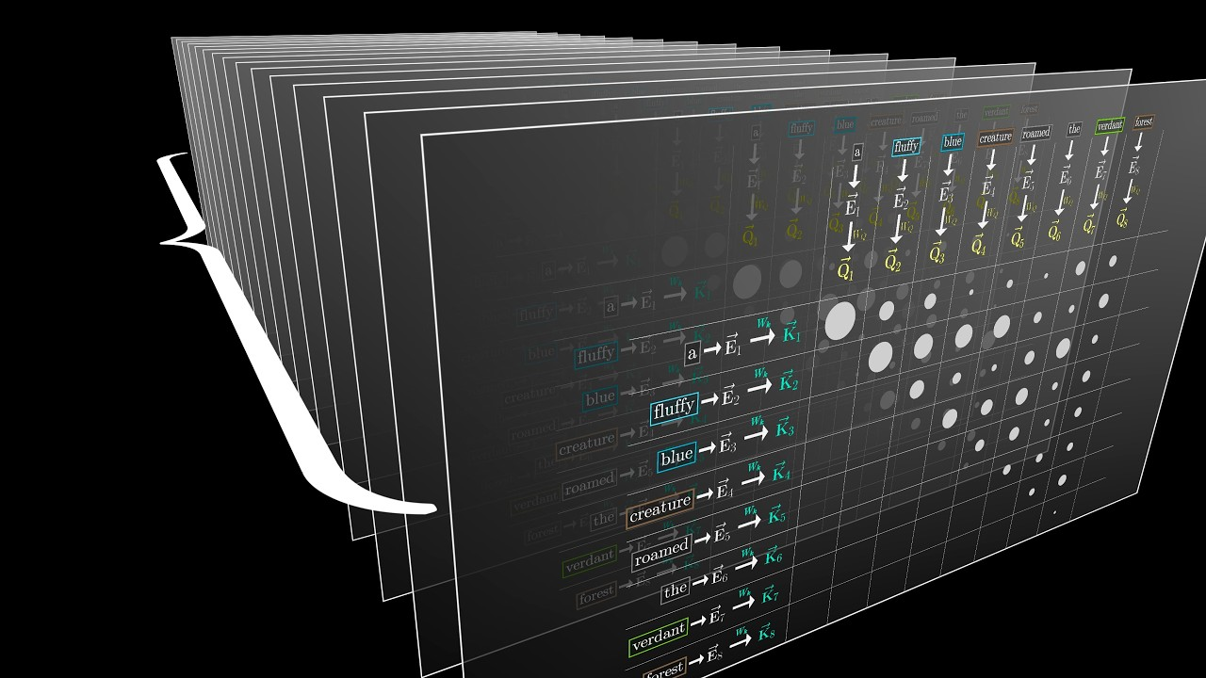
01
Attention
Is All You Need
Presented by
Xingjian Han
Anh Minh Nguyen
Kang Hong

Slide 2
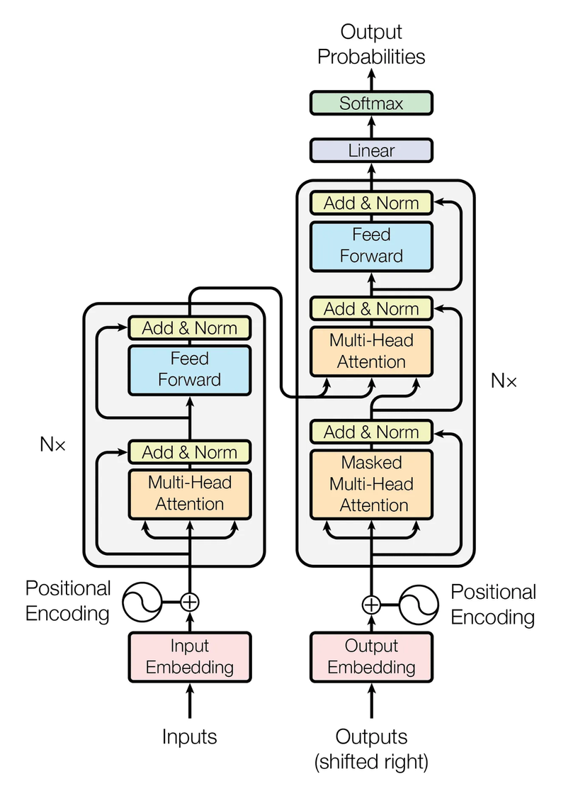
02
Transformer
Encoder-Decoder
Self-Attention Mechanism
Multi-Head Attention
Positional Encoding
Feed-Forward Networks
Residual Connections and Layer Normalization
Parallelism

Slide 3
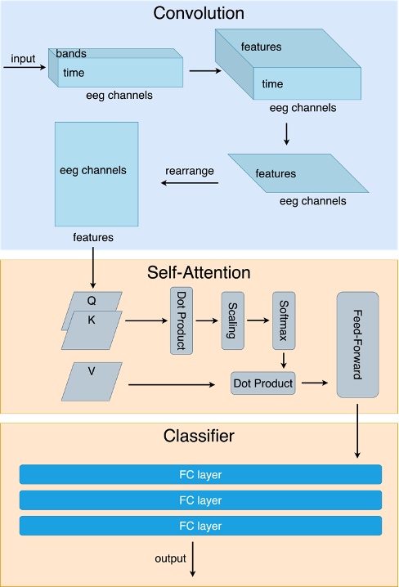
03
Convolutional
Transformer
Convolutional Layer
Feature Upscaling (bands) (5, 10, 62) —> (40, 10, 62)
learnable parameters: 5*40 + 40 = 240
Feature Reduction (time) (40, 10, 62) -> (40, 1, 62)
learnable parameters: 40*40*10 + 40 = 16,040
Rearrange (40, 1, 62) -> (1, 62, 40)

Slide 4
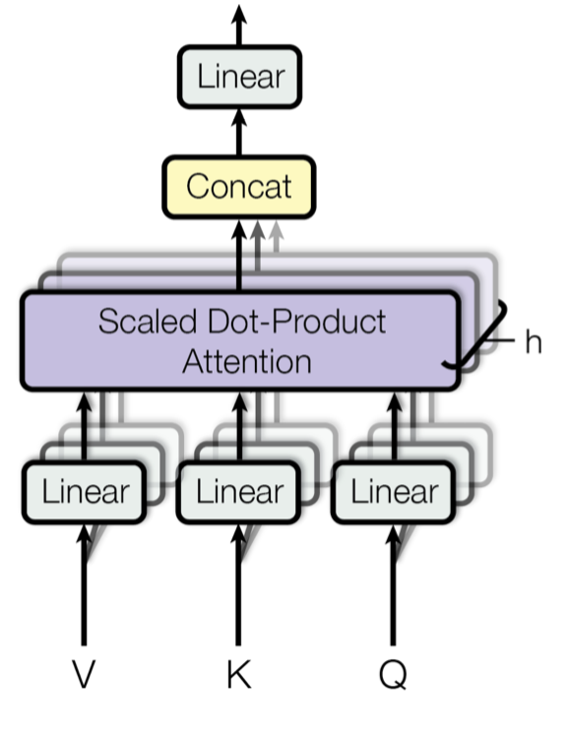
04
Multi-Head Attention
Input (1, 62, 40) —> Q, K, V Linear Layers
learnable parameters: (40 * 40 + 40) * 3 = 4,920
Output (1, 62, 40)
Rearrange (1, 62, 40) —> (1, 10, 62, 4)

Slide 5
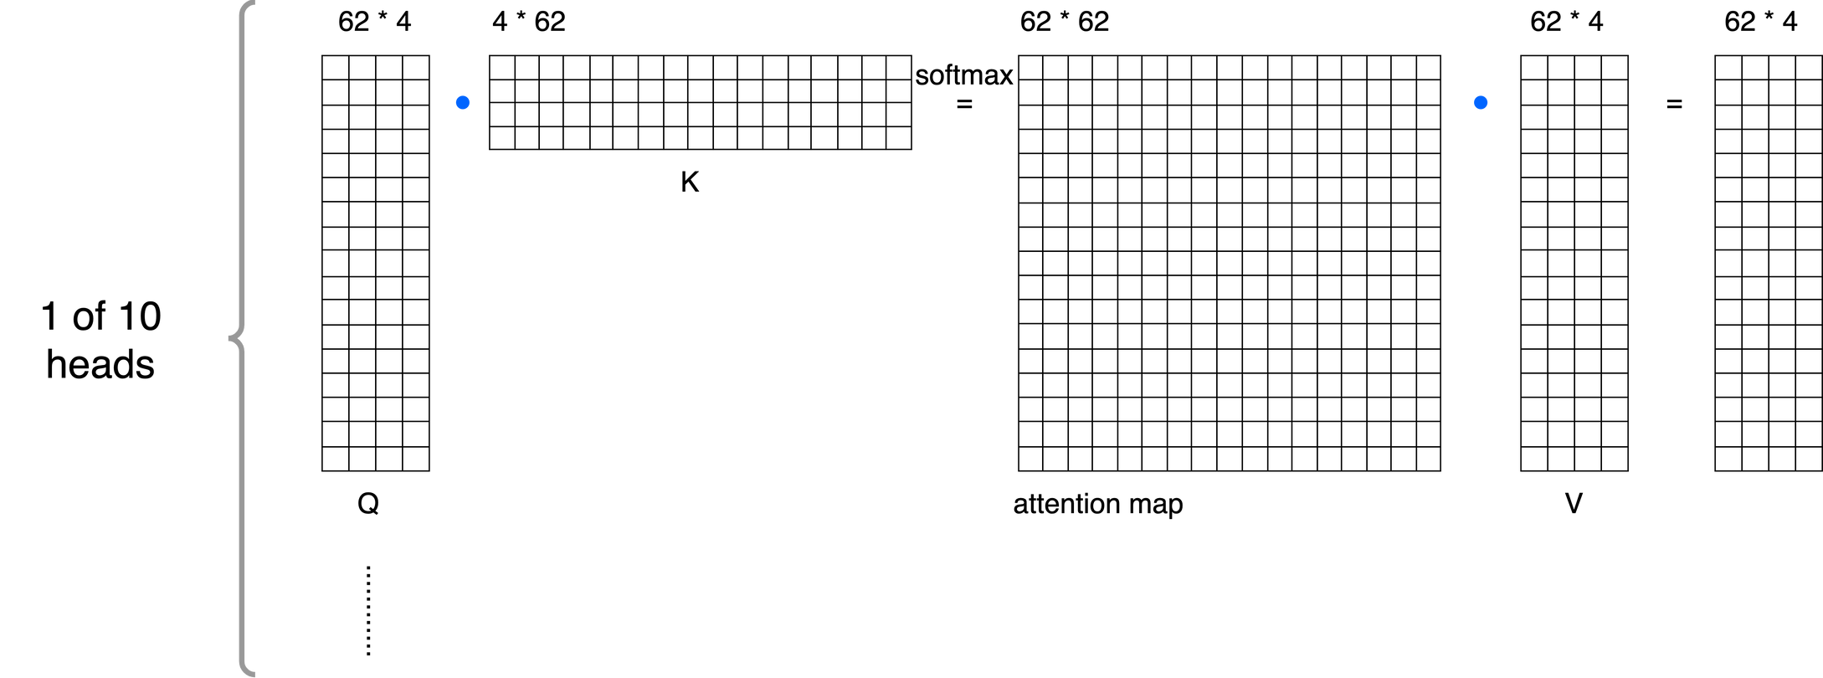
05
Multi-Head Attention
Rearrange (1, 10, 62, 4) —> (1, 62, 40)

Slide 6
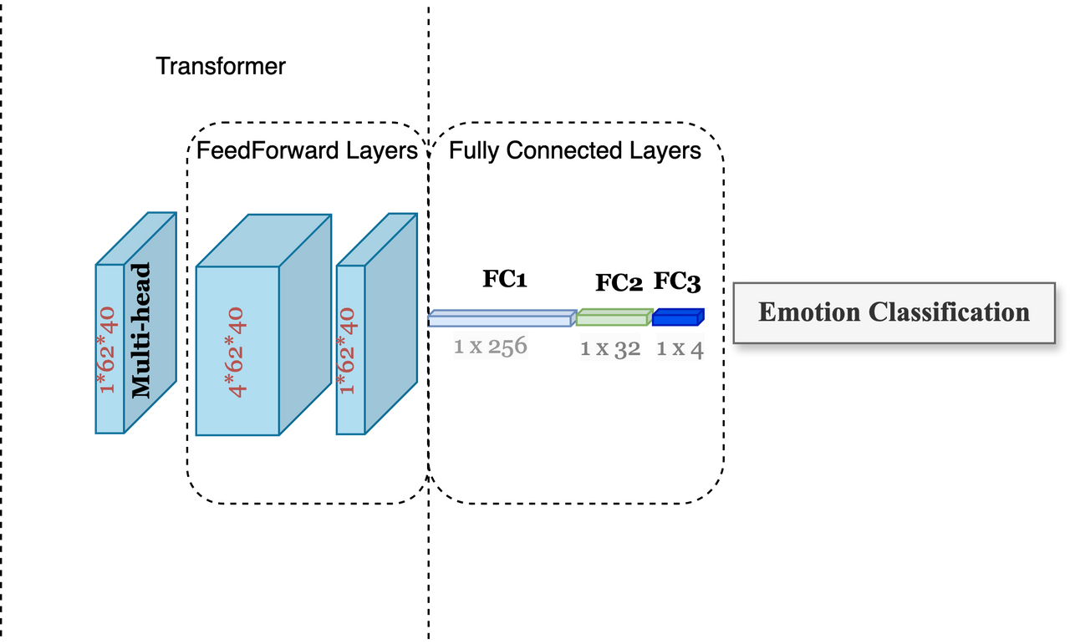
06
Dense layers

Slide 7
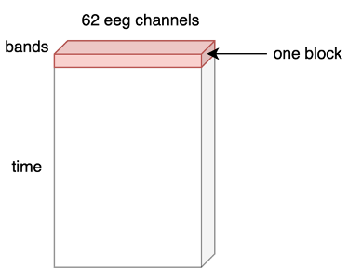
07
Preprocessing
de_LDS with time window of 4 second
block = 10 * time window
5 frequency bands

Slide 8
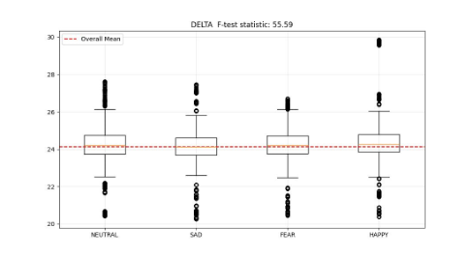
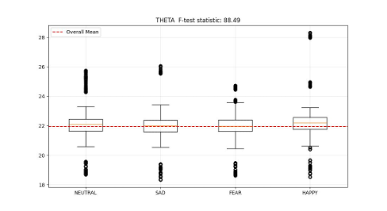
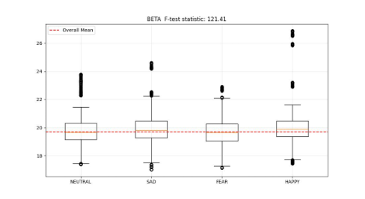
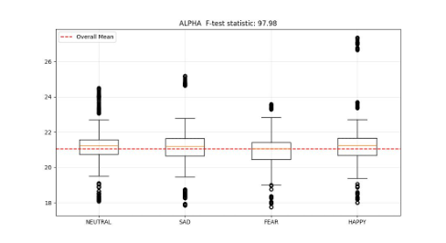
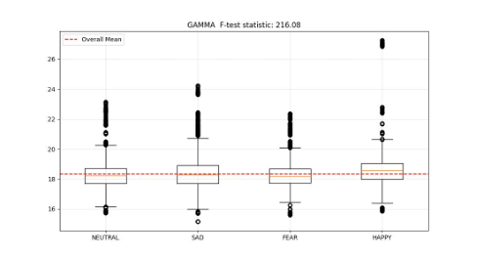
08
EDA
Bands | Delta | Theta | Alpha | Beta | Gamma
F-test | 55.59 | 88.49 | 97.98 | 121.41 | 216.08

Slide 9
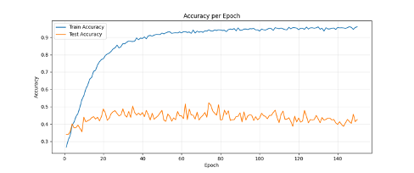
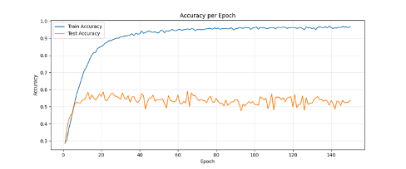
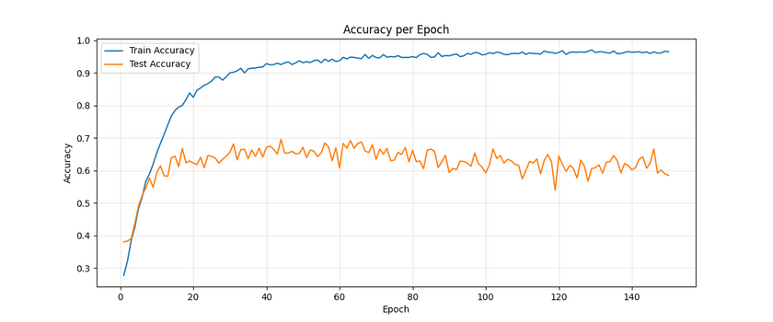
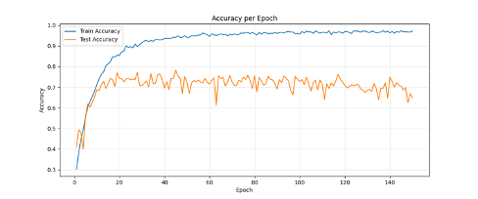
EDA Test
09
2-band
3-band
4-band
5-band

Slide 10
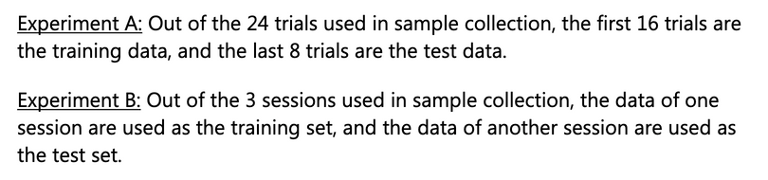
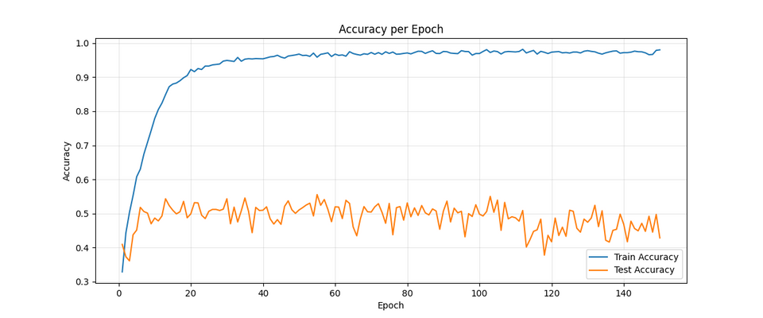
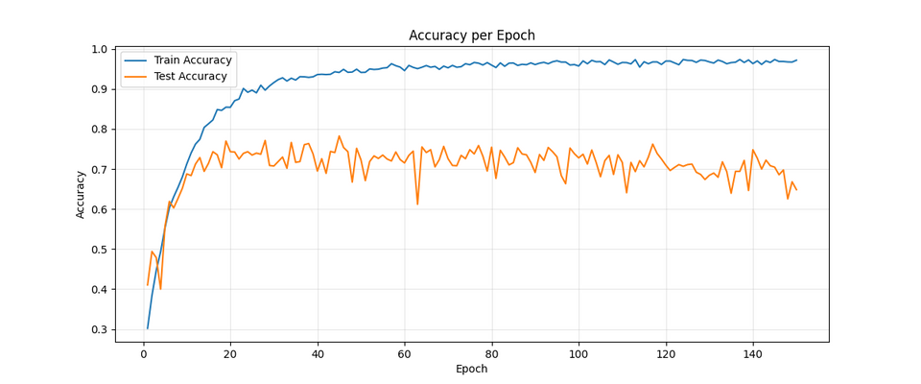
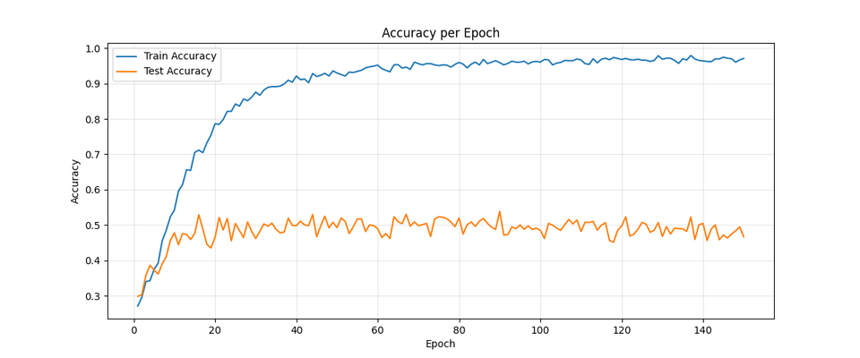
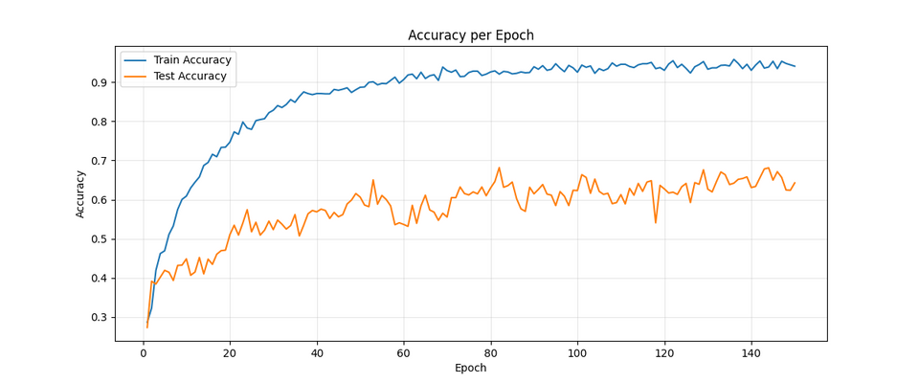
Training
10
A
A
B
B

Slide 11
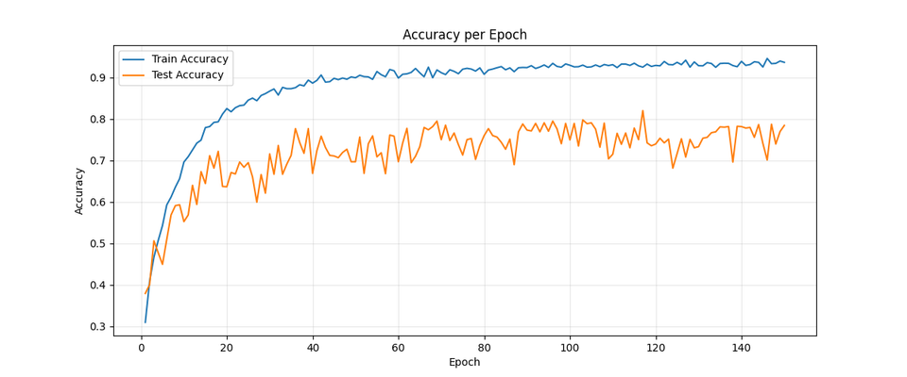
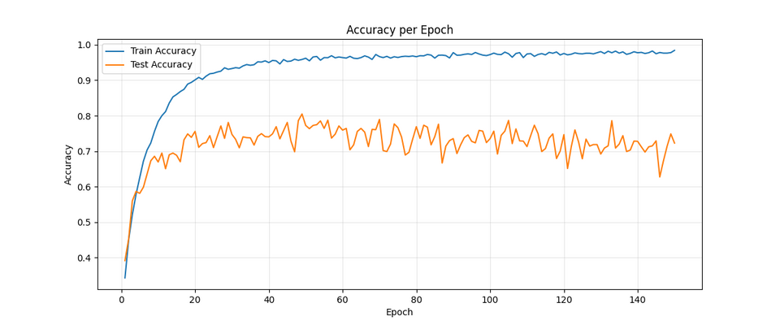
Overfitting Reduction
11
6-layer
2-layer
1-layer

Slide 12
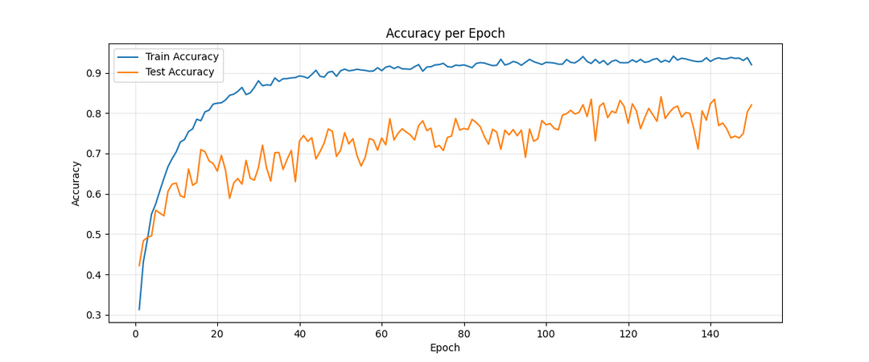
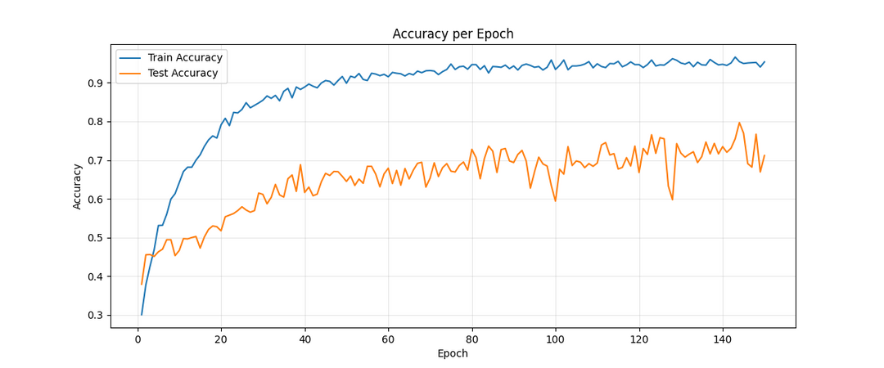
Final Results
12
A
Accuracy (mean):
Experiment A: 83.034
Experiment B: 72.018
B

Slide 13

13
Thank you!
https://github.com/mylakehead/eeg

